Slide 1

Transcranial Magnetic Stimulation Chris Chambers CUBRIC Head of Brain Stimulation

Slide 2
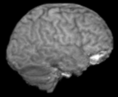
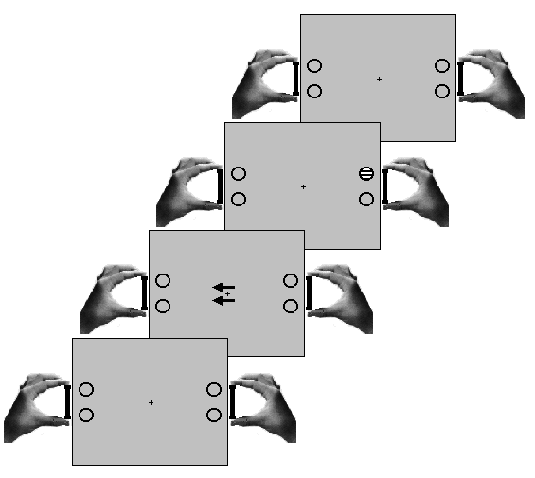
Logic of Neurostimulation
Changes in behaviour that result from stimulation of brain activity can tell us about the causal role of that activity
 | Independent Variable | Dependent Variable | Inference
Neuroimaging | Behaviour | Brain activity | Which brain activity is associated with which behaviour
Neurostimulation | Brain activity | Behaviour | Which brain activity is necessary for which behaviour

Slide 3
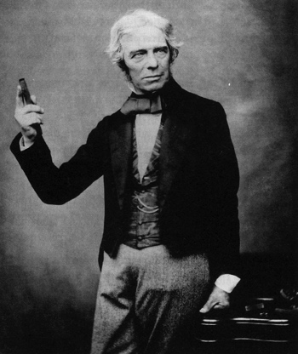
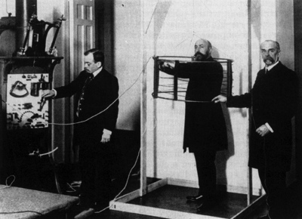
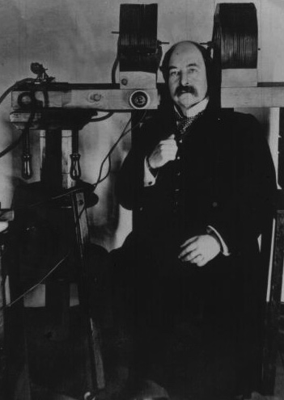
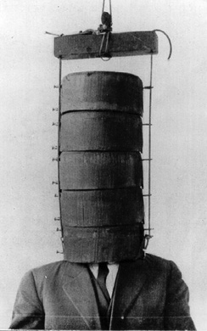
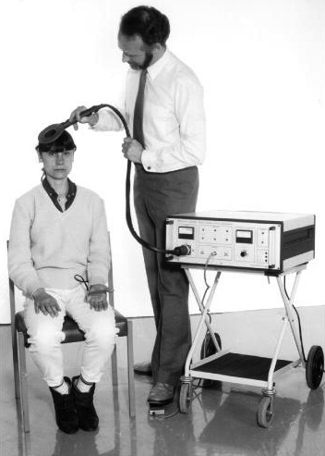
History
Electromagnetic induction
Faraday, 1831
Arsenne d’Arsonval, 1896
Thompson, 1910
Magnusson &
Stevens, 1911
Barker, 1985

Slide 4
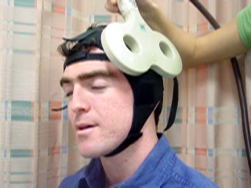
Transcranial Magnetic Stimulation

Slide 5
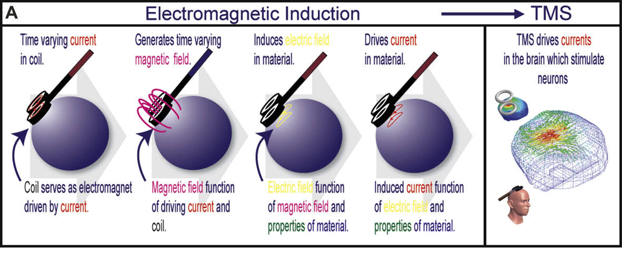
Physics of TMS
TMS exploits Faraday’s law of electromagnetic induction
A time-varying magnetic field induces an electric field, which in turn drives currents in any nearby conductive material
Wagner et al. (2009) Cortex, 45, 1025-1034
TMS activates neurons
it can suppress/enhance perception, elicit phosphenes, alter cortical excitability; useful tool for studying localization of brain function and neural connectivity
also has clinical applications: treatment of depression, epilepsy, migraine, tinnitus

Slide 6
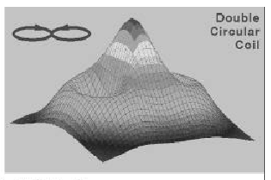
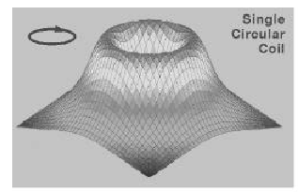
Anatomical Resolution
Difficult and frequently-asked question
the brain is a complex and non-uniform conductor
Anatomical resolution can be assessed locally and remotely
Local effects
beneath the centre of the TMS coil
3D Gaussian function describing likelihood of the induced electric field directly activating a neuron
Influenced by several interactive parameters:
Coil shape
Coil size
Coil orientation and direction of current flow
Output Intensity (magnetic flux density in Tesla)

Slide 7
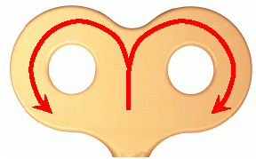
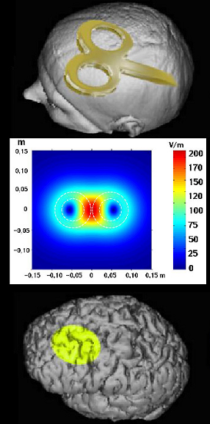
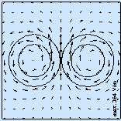
Anatomical Resolution
Coil shape: determines shape of induced electric field
Figure-of-eight coil

Slide 8
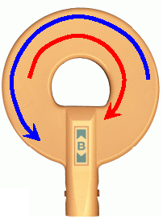
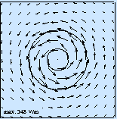
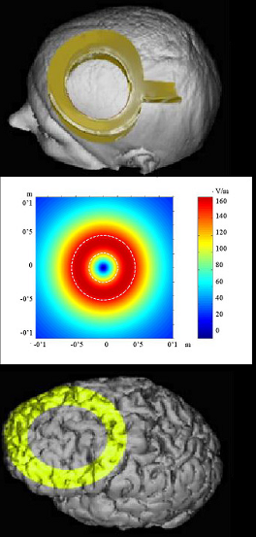
Anatomical Resolution
Coil shape: determines shape of induced electric field
Round coil

Slide 9
Anatomical Resolution
Coil size
smaller coil = smaller electric field = increased focality

Slide 10
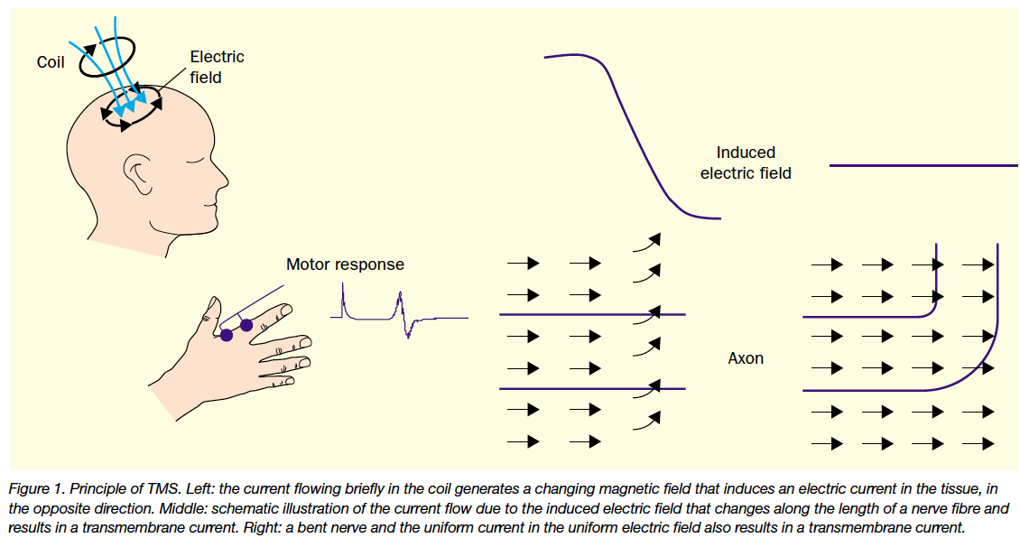
Anatomical Resolution
Kobayashi & Pascual-Leone (2003) Lancet Neurology 2, 145-156.
Coil orientation
determines the direction of the induced current
relationship between current direction and local cytoarchitecture will determine the extent of neural firing
need a trans-membrane current (ion flow) that depolarises the axon membrane and triggers an action potential – fibre bends help

Slide 11
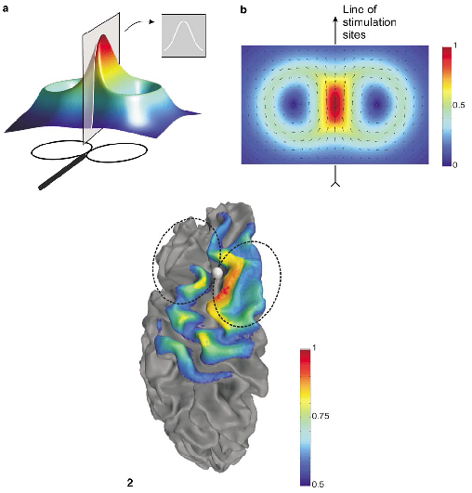
Anatomical Resolution
Coil orientation
At a macro level, this influences current spread across millions of neurons that share a similar orientation (e.g. in M1)
Output Intensity
greater intensity = reduced focality
effective intensity is also determined by scalp-cortex distance
Thielscher & Kammer (2002). NeuroImage, 17, 1117-1130

Slide 12
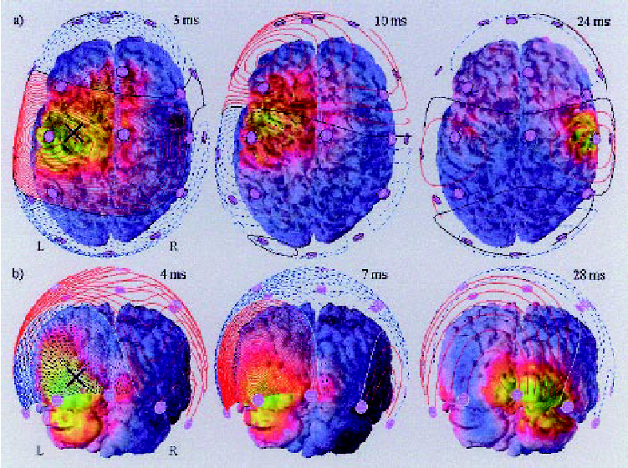
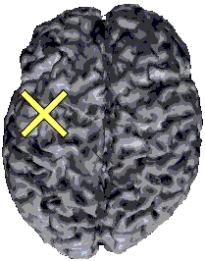
Anatomical Resolution
Remote effects (activity beyond the induced field arising from connectivity)
Depend on all of the factors above, plus functional connectivity
Figure from Ilmoniemi et al. (1997). NeuroReport, 8, 3537-3540

Slide 13
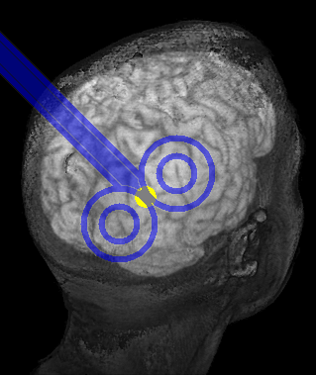
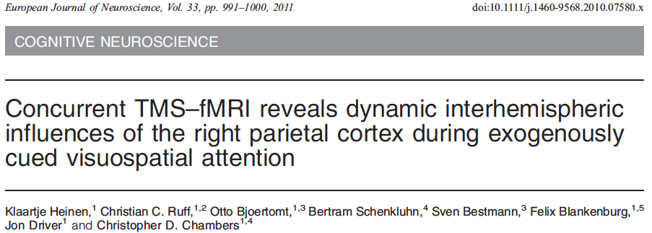
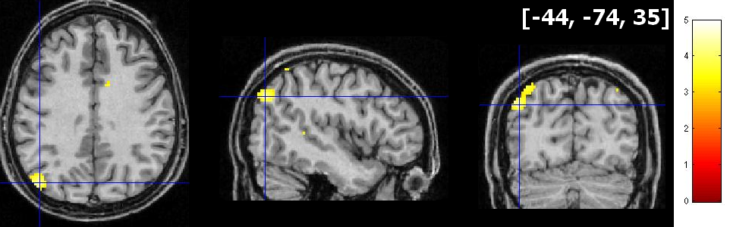
Anatomical Resolution

Slide 14
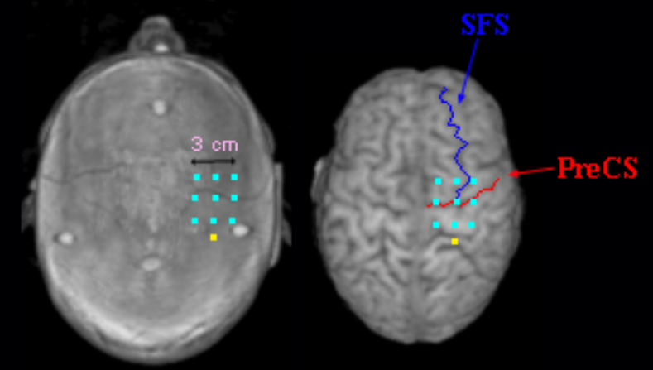
Anatomical Resolution
Conclusion: Physical principles provide only a very general indication of focality
TMS directly stimulates cortex only (max 2-3 cm depth)
It may directly stimulate (0.5) – (2.5)³ cm of cortical tissue, depending on cytoarchitecture, coil size, coil shape, coil orientation, stimulation intensity
‘Functional focality’ can be inferred from the effects of TMS
e.g. motor cortex mapping, comparison of behavioural performance between adjacent brain regions

Slide 15
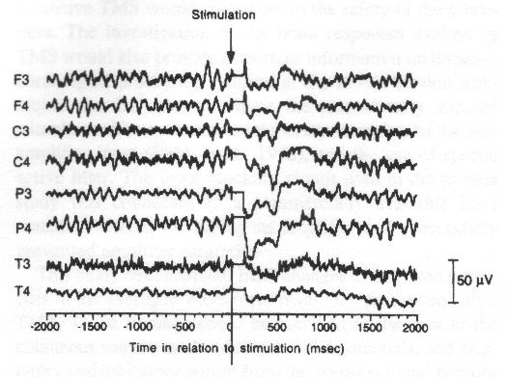
Temporal Resolution
Depends how resolution is measured, how and where TMS is applied, and strength of the induced electric field
EEG measurements suggest that brain activity induced by a single TMS pulse may be altered for up to 600 ms, both locally and remotely
Figure from Izumi et al. (1997). Electro. Clin. Neuro., 103, 319-322.

Slide 16
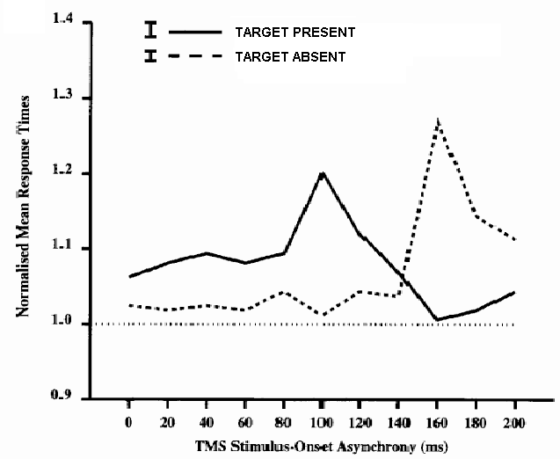
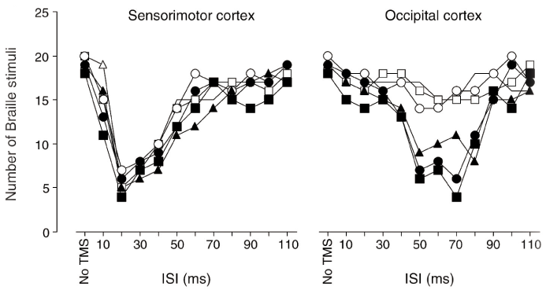
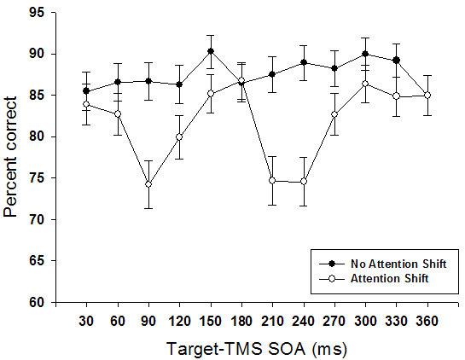
Temporal Resolution
But the temporal resolution of TMS with respect to behaviour is generally much finer (20-50ms bandwidth)
Hamilton & Pascual-Leone (1998). TICS, 2, 168-174.
Ashbridge et al. (1997). Neuropsychologia, 35(8): 1121-31.
Chambers et al. (2004). Nat Neurosci. 7(3):217-8.

Slide 17
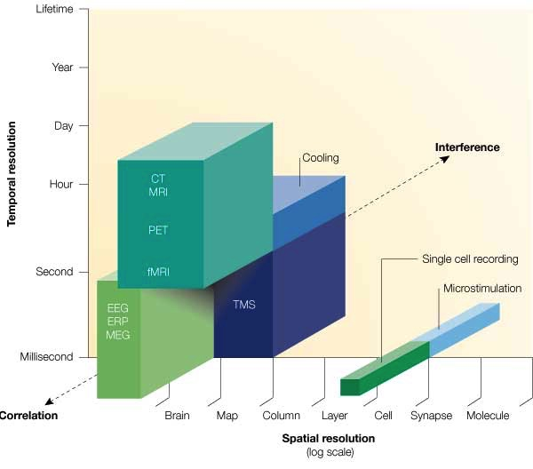
Technical Continuum of Techniques
Figure from Walsh & Cowey (2000). Transcranial magnetic stimulation and cognitive neuroscience. Nat. Rev. Neurosci., 1, 73-79.

Slide 18
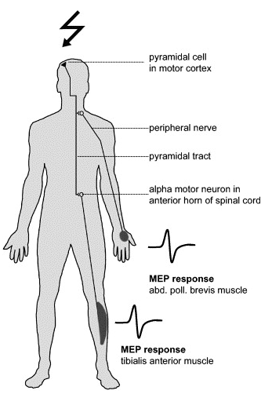
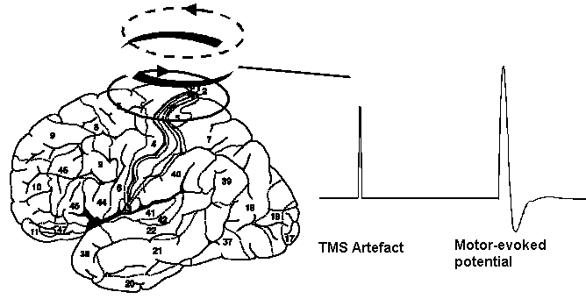
Neurophysiology
Motor evoked potential (MEP)
Basis of TMS motor threshold

Slide 19
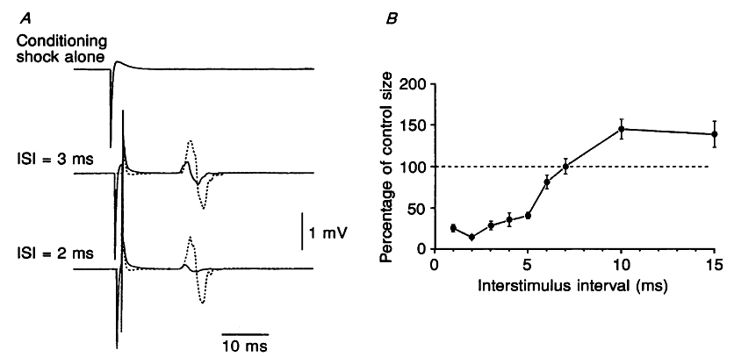
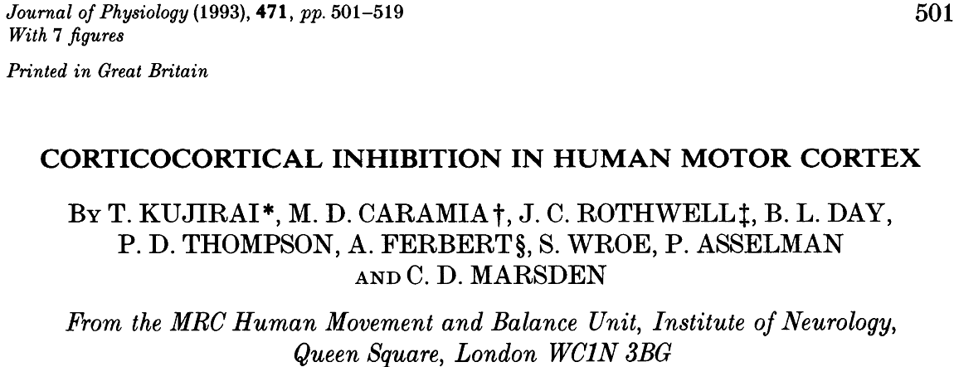
Neurophysiology
Short intracortical inhibition (SICI) and intracortical facilitation (ICF)
SICI and ICF are intracortical physiological mechanisms revealed by paired-pulse stimulation
Initial conditioning pulse is too weak to cause descending spinal activity – yet still alters sensitivity of cortex to subsequent supra-threshold pulse
SICI – linked to GABA_{A} receptor mechanisms
ICF – linked to glutamatergic NMDA receptor mechanisms

